Slide 1
HL7® FHIR® Overview Why should Canada Care?
Lloyd McKenzie
April 7, 2015

Slide 2
This presentation
Can be downloaded here:
http://gforge.hl7.org/svn/fhir/trunk/presentations/2015-04 Canada/HL7 FHIR Overview.pptx
Use “anonymous” and email address to logon
Is licensed for use under the Creative Commons, specifically:
Creative Commons Attribution 3.0 Unported License
(Do with it as you wish, so long as you give credit)

Slide 3

Who am I?
Name: Lloyd McKenzie
Company: Gevity
Background:
One of FHIR’s 3 principle editors
Co-chair FHIR Management Group
Co-chair HL7 Modeling & Methodology
former Chair SCWG6 Architecture & Infrastructure
Heavily involved in HL7 and healthcare exchange for last 15 years (v2, v3, CDA, etc.)

Slide 4
Tutorial Objectives
You should:
Have a sense of what FHIR is and how it compares to other HL7 standards
Be able to explain what makes FHIR different
Know where FHIR is currently being used and where it is in its development cycle
Understand some of the benefits and risks FHIR offers for Canada
Notes:
9:15

Slide 5
What is FHIR?
And how is it different?

Slide 6
The acronym
F – Fast (to design & to implement)
Relative – No technology can make integration as fast as we’d like
H – Health
That’s why we’re here
I – Interoperable
Ditto
R – Resources
Building blocks – more on these to follow
Notes:
9:25

Slide 7

Genesis of FHIR
Board initiated a “Fresh Look”
What would healthcare exchange look like if we started from scratch using modern approaches?
V3 wasn’t getting desired traction
Implementers were struggling with CDA
Much of the world was ignoring both
All indicators pointed to REST
Drafted a healthcare exchange API based on this approach

Slide 8
FHIR – Key differences
Focus on Implementers
Target support for common scenarios
Leverage cross-industry web technologies
Require human readability as base level of interoperability
Make content freely available
Support multiple paradigms & architectures
Demonstrate best practice governance
Notes:
We don’t actually have a formal manifesto, but these are the principles we adhere to.

Slide 9
Implementer Focus
Specification is written for one target audience: implementers (that’s not just programmers)
Rationale, modeling approaches, etc. kept elsewhere
Multiple reference implementations from day 1
Publicly available test servers
Starter APIs published with spec
C#, Java, Pascal, Swift, more coming
Connectathons to verify specification approaches
Instances you can read and understand ☺
Lots of examples (and they’re valid too)
using HL7.Fhir.Instance.Model;
using HL7.Fhir.Instance.Parsers;
using HL7.Fhir.Instance.Support;
XmlReader xr = XmlReader.Create(
new StreamRead
IFhirReader r = new XmlFhirReader
// JsonTextReader jr = new JsonTe
// new StreamRead
// IFhirReader r = new JsonFhirRe
ErrorList errors = new ErrorList(
LabReport rep = (LabReport)Resour
Assert.IsTrue(errors.Count() == 0
Notes:
Spec is driven by people who write code
Numerous pieces have been changed because of experience with what worked when trying to implement
Even have a test workbench for RESTful servers

Slide 10
Support “Common” Scenarios
80%
Inclusion of content in core specification is based on “80%” rule
Only include data elements we are confident that most (~80%) of normal implementations using that resource will make use of
Other content in extensions (more on this later)
Easy to say, governance challenge to achieve
Resources are simple and easy to understand & use
Notes:
Design by constraint failed – years to develop, what was produced required yet more design to be implementable and after that might not be interoperable
How to determine the 80%? Look to existing specs – v2, v3, CDA templates, OpenEHR, jurisdictional projects, what implementations we’ve seen
If not sure, err on the side of “not in for now”
Note: not 80% of instances, 80% of implementations
Challenges with “raising the bar”
What happens when there aren’t many/any implementations?

Slide 11
Example – ISO AD type
isNotOrdered, updateMode, flavorId, nullFlavor, controlAct root & extension, validTime low and high, useable period (GTS – no room on the slide), use
home, primary home, vacation home, workplace, direct, public, bad, physical, postal, temporary, alphabetic, ideographic, syllabic, search, soundex, phonetic
0..* parts, each with:
value, code, code system, code system name, code system version, language, type:
address line, additional locator, unit identifier, unit designator, delivery address line, delivery installation type, delivery installation area, delivery installation qualifier, delivery mode, delivery mode identifier, street address line, building number, building number numeric, building number suffix, street name, street name base, street type, direction, intersection, care of, census tract, country, county or parish, municipality, delimiter, post box, precinct, state or province, postal code, delivery point identifier
Notes:
How many of your systems have user interfaces that support even ¼ of this?

Slide 12
Example – FHIR Address
isNotOrdered, updateMode, flavorId, nullFlavor, controlAct root & extension, validTime low and high, useable period (low, high) (GTS – no room on the slide), use
home, primary home, vacation home, workplace, direct, public, bad, physical, postal, temporary, alphabetic, ideographic, syllabic, search, soundex, phonetic, old
0..* parts, each with:text
value, code, code system, code system name, code system version, language, type:
address line, additional locator, unit identifier, unit designator, delivery address line, delivery installation type, delivery installation area, delivery installation qualifier, delivery mode, delivery mode identifier, street address line, building number, building number numeric, building number suffix, street name, street name base, street type, direction, intersection, care of, census tract, country, county or parish, municipalitycity, delimiter, post box, precinct, state or province, postal codezip, delivery point identifier
Notes:
This is what happens when you apply the 80% . . .

Slide 13
Won’t extensions break interoperability?
The 80% + narrative helps provide “base” interoperability
For “robust” interoperability
Profile – constrains structure
Conformance – constrains behavior
Needed to claim “I’m FHIR conformant”
Notes:
1000s of extensions, everyone supports different things, don’t know what anyone does
Not everyone will support the 80%, but most will
“What most systems support” (and thus what you should probably support too) encourages base interoperability
Human readable fallback
Profile – what elements are supported, registries available
Conformance – REST operations, documents, messages, services

Slide 14
Paradigms
FHIR supports 4 interoperability paradigms
REST – Lightweight, leverages web stack
Documents – Long-term persistence
Messages – Request/response paradigm
Services – other SOA-based interfaces
Regardless of approach, content stays the same
Can leverage same models, same profiles everywhere

Slide 15
FHIR Resources
Notes:
10:00

Slide 16

Resources
“Resources” are:
Small logically discrete units of exchange
Defined behaviour and meaning
Known identity / location
Smallest unit of transaction
“of interest” to healthcare
V2: Sort of like Segments
V3: Sort of like CMETs

Slide 17
What’s a Resource?
Examples
Non-examples
Administrative
Patient, Practitioner, Organization, Location, Coverage, Invoice
Clinical Concepts
Allergy, Condition, Family History, Care Plan
Infrastructure
Document, Message, Profile, Conformance
Gender
Too small
Electronic Health Record
Too big
Blood Pressure
Too specific
Intervention
Too broad
100-150 total - ever
Notes:
And few systems will ever see more than 40-50

Slide 18
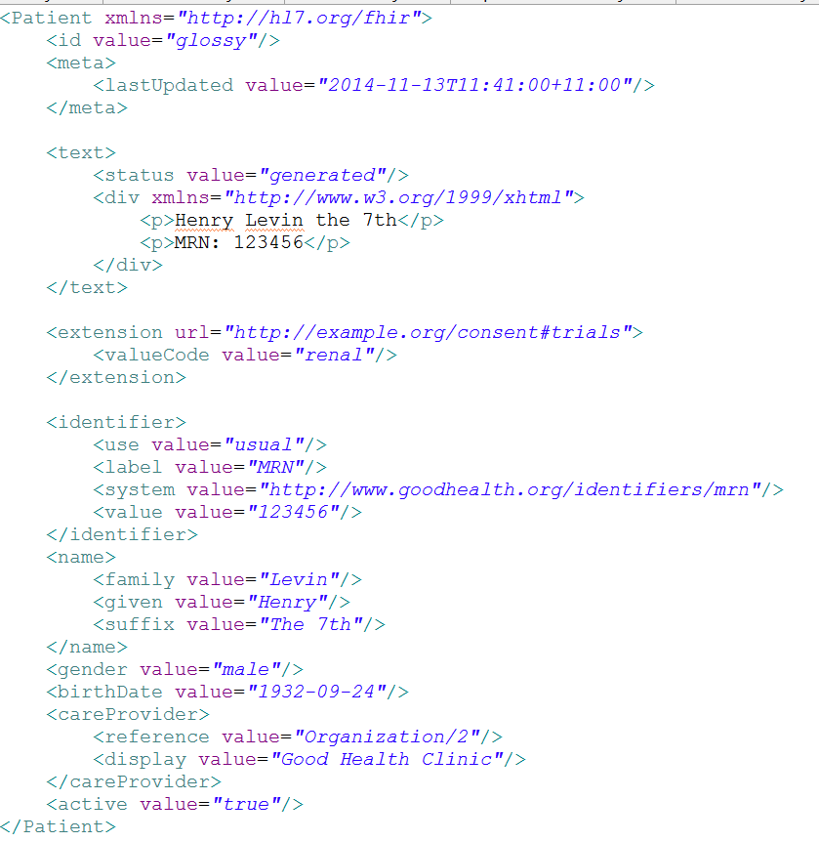
Identity & Metadata
Human Readable Summary
Extension with reference to its definition
Standard Data Content:
MRN
Name
Gender
Date of Birth
Provider
Notes:
System for gender is wrong . . .

Slide 19
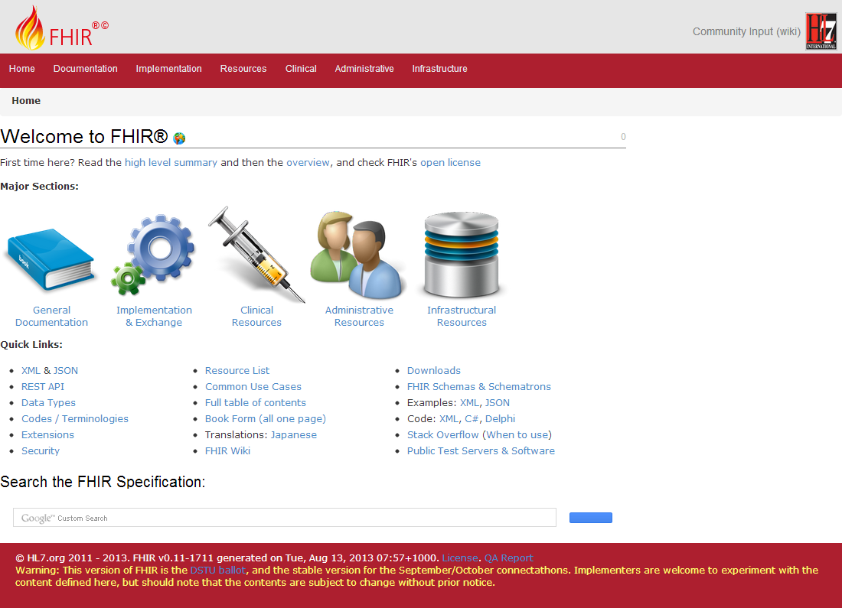
(FHIR home)
hl7.org/fhir
Notes:
Published as HTML
Published using validation process that performs consistency checks – like a software build
Really shouldn’t require much guidance to read, but a few things to call out
Objective of spec is developer can skim and decide in < day

Slide 20
How does FHIR compare?
Notes:
11:30

Slide 21
V2 and FHIR
Similarities
FHIR Differences
Built around re-usable “chunks” of data
Strong forward/backward compatibility rules
Extensibility mechanism
Each chunk (resource) is independently addressable
More than messages
Human readable required
Extensions don’t collide, are discoverable
Modern tools/skills
Instances easy to read
Lighter spec
Notes:
Many interface engine vendors working on FHIR support
May make sense for internals of some v2 systems
Add-on interface for mobile, personal health record

Slide 22
V3 and FHIR
Similarities
FHIR Differences
Based on RIM, vocab & ISO Data types foundations
Support XML syntax
Simpler models & syntax (reference model hidden)
Friendly names
Extensibility with discovery
Easy inter-version wire compatibility
Messages, documents, etc. use same syntax
JSON syntax too
Notes:
Lower learning curve
Unlikely to see significant new v3 initiatives in areas that aren’t already committed to it

Slide 23
FHIR and CDA
Similarities
FHIR Differences
Support profiling for specific use-cases
Human readability is minimum for interoperability
APIs, validation tooling, profile tooling
(See v3 similarities on prior slide)
Can use out of the box – no templates required
Not restricted to just documents
Implementer tooling generated with spec
(See v3 differences on prior slide)
Notes:
Significant work on CCDA <-> FHIR
Can use both FHIR and CCDA documents with XDS and with MHD

Slide 24
FHIR and Services
Similarities
FHIR differences
Encourage context neutral, re-usable structures with defined behavior
RESTful interface is a simple SOA interface
Consistent data structures across services
Ease of transport across paradigms message <-> service <-> document <-> REST
Standard framework for defining/discovering services
Notes:
FHIR allows defining simple services via the “OperationDefinition” mechanism as well as custom services.
E.g. Value set expansion, code translations – full terminology services

Slide 25
So why use anything else?
FHIR is brand new
Minimal market share
Not yet normative
Limited track record
Business case
No-one dumps existing working systems just because something new is “better”
Most Large projects committed to one standard won’t change direction quickly (or even at all)

Slide 26
FHIR as a replacement
Yes, FHIR has the potential to supplant HL7 v3, CDA and even v2
However
It’s probably not going to do so right away
HL7 will support existing product lines so long as the market needs them
Notes:
Few will throw away their investment in older standards to use FHIR until
The specification has a good track record
It’s clear the new thing provides significant benefits

Slide 27
Status of FHIR

Slide 28
FHIR Timeline
Conception: Sept 2011
DSTU 1: Jan 2014
DSTU 2: ballot now, publish this summer
Normative: 2017
Subsequent editions ever 18-24 months
Increasing stability based on implementation, connectathons, etc.

Slide 29
Who’s using it?
Only in DSTU, however implementation is widespread
Epic, Cerner, McKesson, Mayo, Kaiser, IBM, etc. involved through Health Services Platform Consortium (HSPC)
ONC sponsoring 3 projects, positioning for FHIR in MU 3
IHE has/working on several FHIR IGs
CDA and CCDA on FHIR projects in HL7
100s of implementers in 20+ countries
Many systems already in production

Slide 30
Benefits for Canada
Single wire format world-wide
Easier for vendors to market products in multiple countries (and multiple provinces)
Profiling & extensions allows transparent interoperability
Inter-version wire compatibility
Partners can upgrade independently
Messaging + documents + services
Reduced learning curve, off-the-shelf technology
Lower costs, faster implementation

Slide 31
Risks for Canada
Diverting energy at HL7
Vastly less energy around v3
Reduced (and declining) interest around “traditional” CDA
Has captured significant US attention
Even less interest from international vendors in custom v3 Canadian solutions
Still not stable
Not normative until 2017+, hard sell before then
Infoway may not be in position to take the lead on Canadian FHIR Profiles
Possible it won’t be necessary either?

Slide 32
Recommendations
Pay attention
FHIR ballot is open now – review and comment
Get people up to speed on what it is (training, just looking at the spec)
Explore using FHIR in green-field/experimental areas
Particularly good for mobile health, PHR, registries
Where possible, architect interoperability solutions so FHIR can plug in when needed

Slide 33
Next Steps
For you and your organization

Slide 34

Education opportunities
In Canada
FHIR® North Connectathon April 29th
e-Health presentations
Attend a Working Group Meeting
Tutorials, Connectathons
May 8-14 Paris
October 2-9 Atlanta
Attend an Implementation Workshop
July 13-15 DC
November 16-18 Dallas
FHIR Institute Webinars
April 20-24 (Covers Day 1 from this implementation workshop)
Notes:
Disclosure – Gevity is a sponsor of FHIR North and will be presenting at e-Health
I’ll be doing the implementation workshops and Webinars

Slide 35
Final message
FHIR
is easier and cheaper
is being implemented now
is likely to significantly impact Health IT
Canada needs to look at it now and start planning for where and how it will fit

Slide 36

Questions?
http://hl7.org/fhir lmckenzie@gevityinc.com

